Slide 1


Slide 2
PWA?
Notes:
PWAs are a cross between a traditional website and a mobile application. They are built using web technologies like hypertext markup language (HTML), cascading style sheets (CSS), JavaScript and web application programming interfaces (APIs), offering a user experience like a mobile app.
PWAs are popular because they are installable to all platforms using the same code base, they operate while offline and in the background. They can integrate with other services such as the device, other installed apps and access databases. Twitter and Hulu are the most well-known platforms utilising PWA standards.
In simple terms, a PWA is basically a website that behaves like an app it can be installed, works offline, and feels fast and smooth like a native mobile application."
More on this later

Slide 3
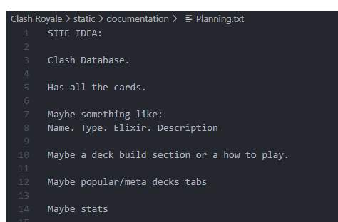
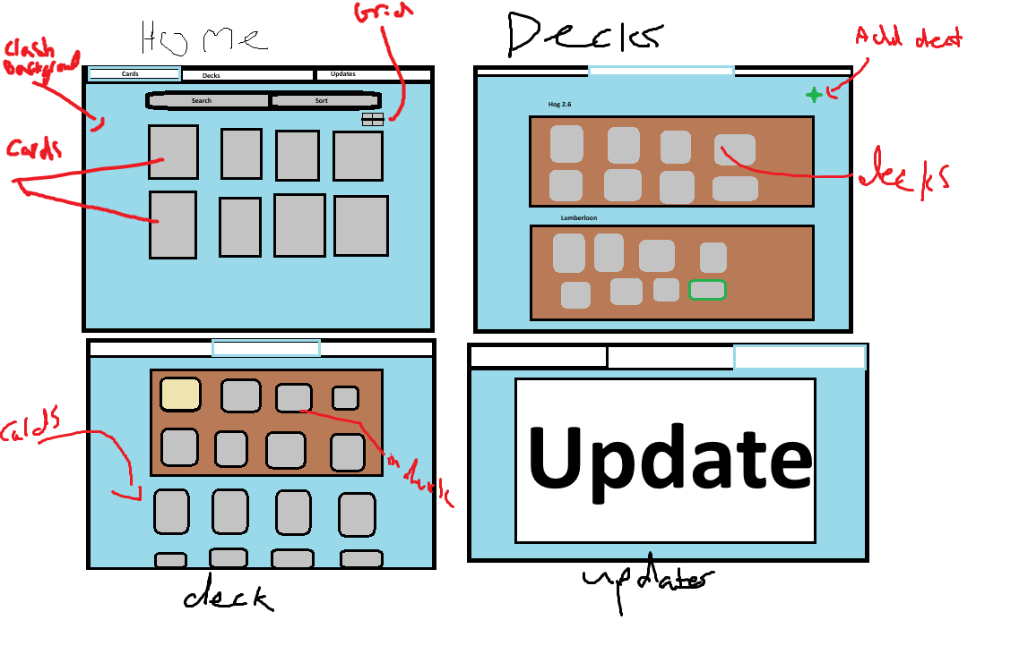

Slide 4
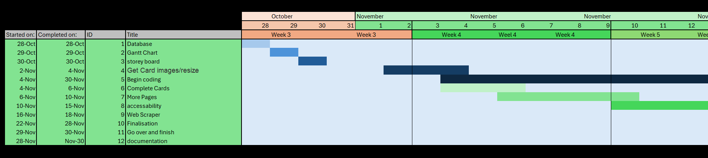
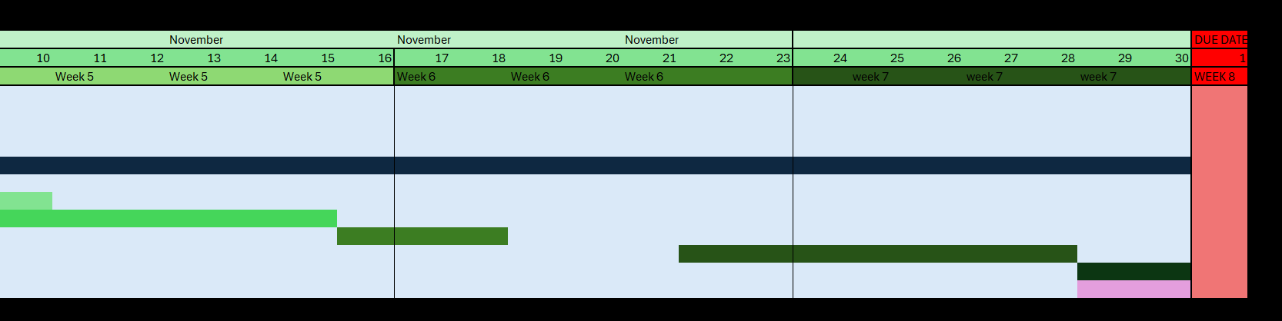

Slide 5


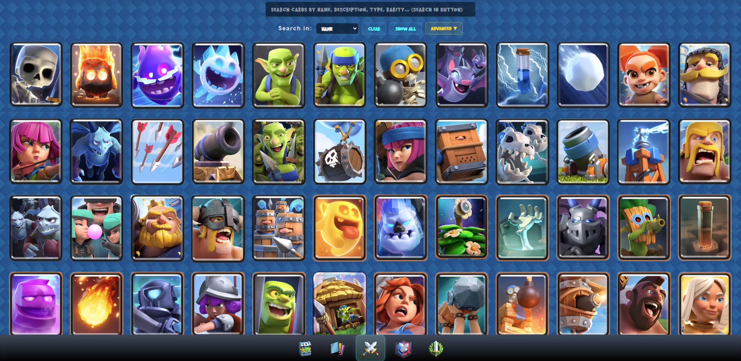

Slide 6

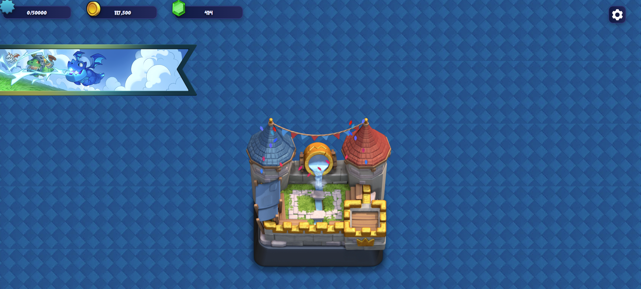

Slide 7

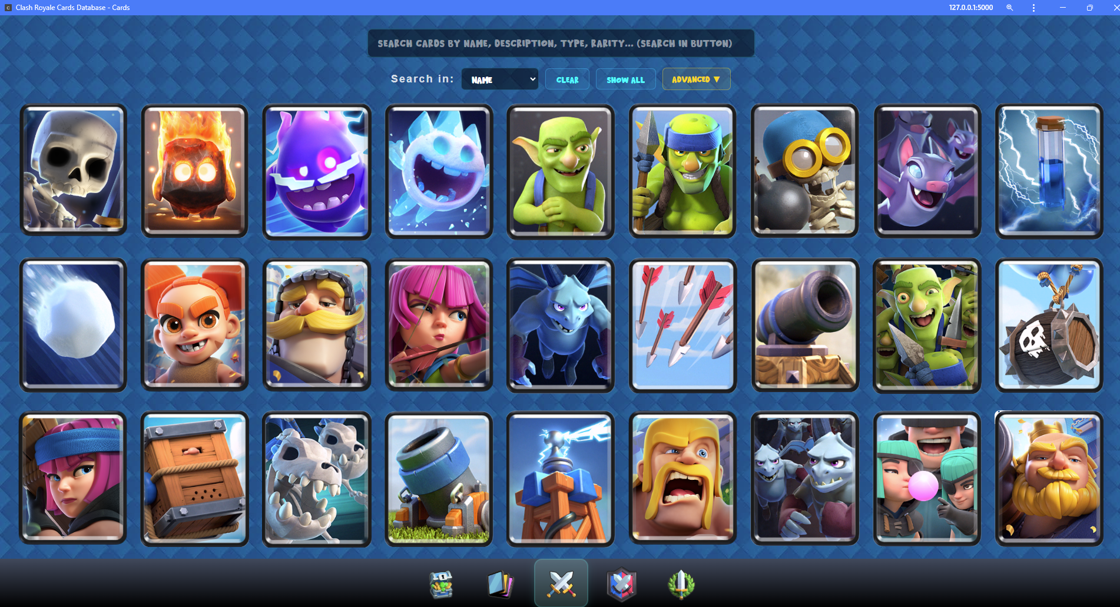
PWA – Again?

Slide 8
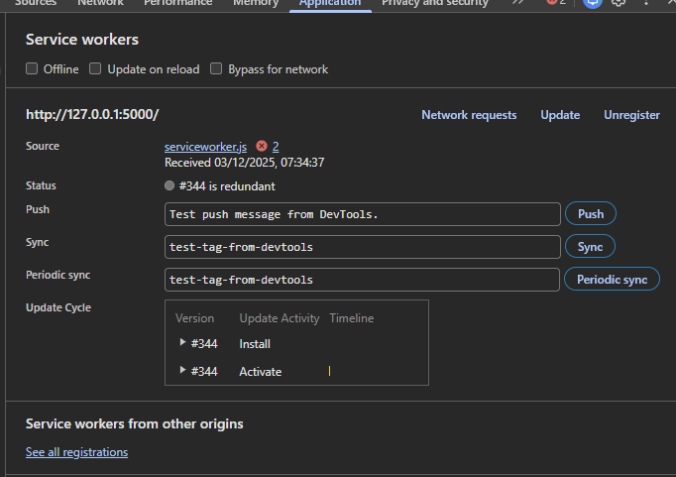
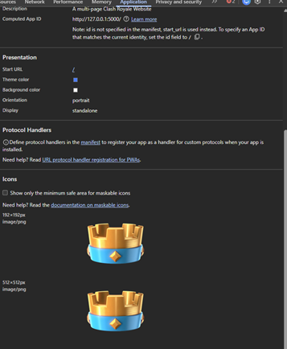

Slide 9


(RoyalAPI.com)
EXTRA FUN BITS!
Web Scraping

Slide 10
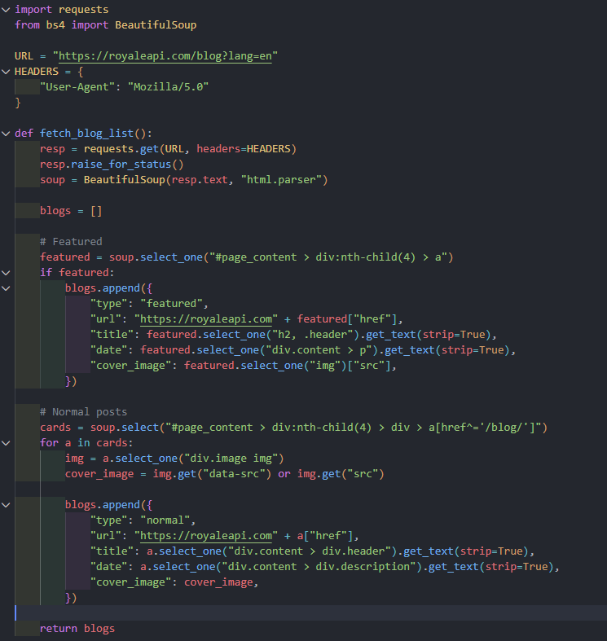
How does it work?
Notes:
("#page_content > div:nth-child(4) > a")
CSS SELECTOR

Slide 11
Website View now!

Slide 12
Questions

